Slide 1
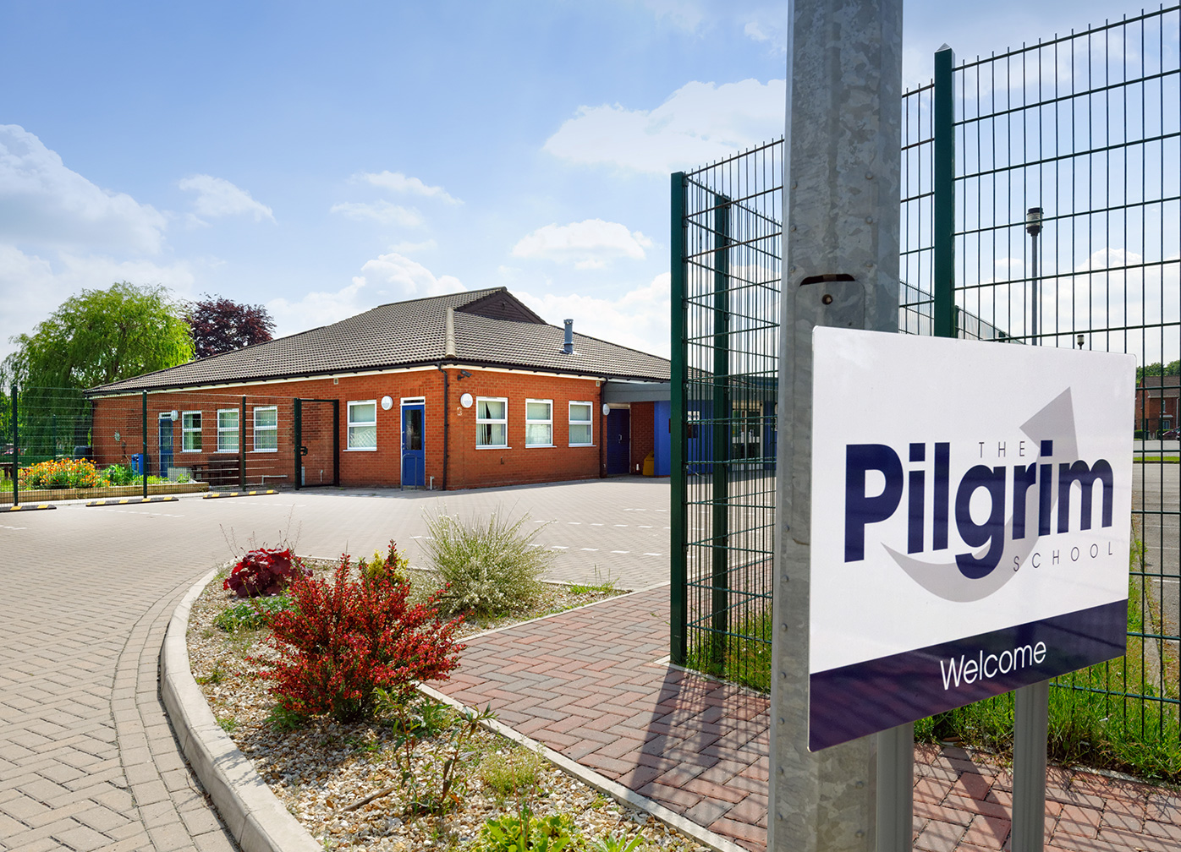
Careers Education, Information, Advice and Guidance - Labour Market Information (LMI)
By
Neil Blackwell
Careers and Community Liaison Manager
The Pilgrim School

Slide 2
Aims of the Presentation
To provide you information about me and my role.
Explain what is Labour Market Information (LMI).
How can LMI be accessed.
Understand how to access trusted LMI sources.
The benefits of collaborative working with child and school.
Work Experience.
How AI can help with careers.
Notes:
Explain the aims of the presentation and the emphasis on LMI and link this with Post-16 choices and AI.
Confirm that there will be a review of the aims at the end of the presentation to confirm whether I have met the aims and open feedback.
Questions can be asked throughout the presentation and/or at the end of the presentation.

Slide 3
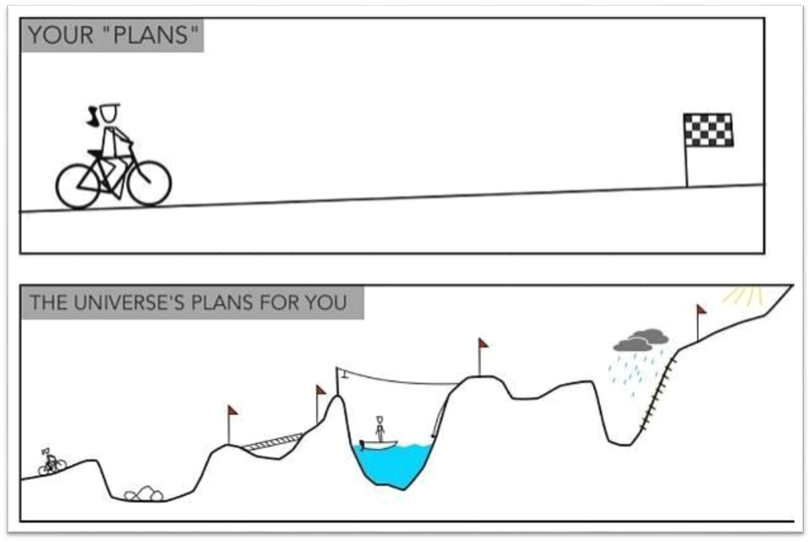
Background and Qualifications
Worked for a solicitor as an office junior
Royal Air Force – Served 28 years (Personnel and Welfare)
Lincolnshire County Council SEND – 1 Year
The Pilgrim School – 9 Years
BSc (Hons) Psychology
MSc Psychology
Trauma Risk Management Practitioner
Level 6 Careers Counsellor
Notes:
To emphasise that careers are not necessarily a straight line from A to B. Careers change and individuals can re-train to undertake various jobs during their working life. There is no right or wrong career path and people achieve in different ways.
Discuss planned happenstance – in my case working for a solicitor who was an ex-army Major who encouraged me to follow my dream and join the Royal Air Force.

Slide 4
My role at The Pilgrim School
Careers Counsellor
Work Experience Co-ordinator
School Trips Organiser
(Across all 3 bases and home taught pupils)
Contact Details (Part time usually Thursday and Friday)
Phone: via Lincoln Base 01522 682319
E-mail: neil.blackwell@pilgrim.lincs.sch.uk
Notes:
Careers counsellor includes Careers 1:1 with Years 10 and 11 pupils. These can be conducted both in school base or at home. If pupil is too anxious to take part, parents or guardians can be included. I can adapt the session to accommodate pupils needs.
Work experience can be accessed by pupils in Years 10 and 11 and pupils should, in the first instance, discuss with their PSWS who in turn will make contact with myself. Work experience can take place over 1 – 2 weeks and can be a full week or just one day a week over a few weeks. The placement will be fully risk assessed and a pre-visit will have taken place by myself. An agreement is prepared and signed by both employer and parent/guardian(s).

Slide 5
Careers Work
Careers 1:1 sessions (Information, Advice and Guidance)
Careers group work
Careers education
Careers visits to colleges and post-16 providers
Careers visits to employers
Careers talks by external agencies
Work experience
Discussions with Year 9 pupils around GCSE options
Notes:
I run a programme of visits between September and March for Year 11 pupils to visit various post-16 placements, experience various work places and have talks from companies about apprenticeships.
More recently I conduct discussions with Year 9 pupils about their GCSE options and how they might want to start thinking about how these may link to their aspirations.

Slide 6
Labour Market Information (LMI)
Labour Market Information (LMI) is a useful tool to help research future jobs in the local area, understand the skills needed for certain roles and the demand for future employment.
LMI helps to break down the complex ‘world of work’– ranging from descriptions of different careers, their entry routes, promotional prospects, salaries paid, skills and qualifications needed, etc. Crucially for young people, LMI also covers future demand – what kinds of jobs will be in demand after leaving school and what kinds of skills will be needed.
(Taken from Nelson and Colne College Group 2025).
Notes:
What is LMI?
We will discuss this in more depth next.

Slide 7
Careers Websites and Information
National Careers Service
NHS Jobs
Indeed
FindaJob.gov.uk
Linkd In
Careers Fairs at Post-16 providers/schools
Office for National Statistics – LMI overview
Armed Forces Careers
Civil Service Careers
Notes:
There are various websites and information sources that advertise jobs in various sectors and locations both in the UK and overseas.
Consider that there are various roles within sectors. An example in the NHS not all roles are clinical eg Facilities Management.
Beware of websites that are unreliable as possibly out of date or have political motivations or are just misinformation.

Slide 8
Work Experience
Can take place half a day a week, full day a week, over one week or over two weeks – and anything inbetween.
I will try to find something aligned to their career aspirations.
Safeguarding.
Risk Assessments.
Parent/Employer Agreement.
Virtual or Face to Face.

Slide 9
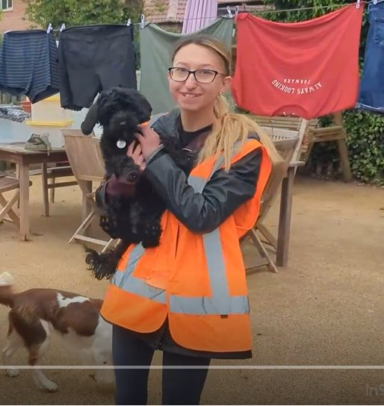
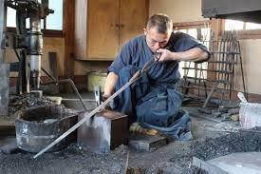
Work Experience Cont'd
Notes:
Some examples of past pupils who engaged in work experience and have gone on to be very successful:
1. A pupil from Lincoln base who went on a placement with Access to Music. She went on to study music at a prestigious university in London and writes and publishes her own music on Spotify. She also is a part time model for a large modelling agency in London and this is her on the catwalk during the Paris Fashion Week.
2. A pupil from Lincoln base who completed a full work experience programme at a Dog Rescue Centre and went on to work at the centre and is now a supervisor and trains volunteers.
3. A pupil who spent a week at RAF Scampton with the Red Arrows Team; she went on to join the RAF as a photographer.
4. A pupil from the Sleaford base who completed a placement at Tesco in Sleaford. He is now a supervisor and team lead at a large supermarket in Lincolnshire.
5. A pupil from our Louth base who struggled in the classroom with both engagement and attendance, completed a placement as a mechanic and was very successful. He went on to become a sword smith and makes swords and armour for reenactments.

Slide 10
Collaborative Working
Careers Adviser/Parent or Guardian(s)/Pupil to work together to apply for Post-16 placements during Year 11.
All parties including external agencies (where needed) to ensure a successful work experience placement.
If a pupil is particularly anxious, including PSWS/parent or guardian in the Careers 1:1 session.
Notes:
Working collaboratively will help your child especially during the stressful process of securing the right Post-16 placements for them. I have found that working in tandem ensures that all parties are aware of the goal that we are trying to achieve and can ensure that information shared is relevant and up to date.
If a pupil has a specific need that needs considering during a work experience placement then working with parents/school/pupil/external agencies can ensure that appropriate safeguarding measures are in place.

Slide 11
How Understanding AI Helps Kids Prepare for Future Careers
🔍 Awareness of Emerging Fields AI is transforming industries—healthcare, finance, art, transportation, and more. Understanding AI introduces kids to new and evolving career options.
🧠 Builds Critical Thinking & Problem-Solving Skills Learning how AI works teaches logic, algorithms, and ethical reasoning. Encourages curiosity and innovation.
🤖 Prepares for Human-AI Collaboration Many future jobs will involve working with AI, not being replaced by it. Kids who understand AI will adapt faster in tech-driven environments.
💡 Inspires Creativity and Interdisciplinary Thinking AI is not just for coders—it's used in music, design, storytelling, and sports. Shows kids how they can mix their passions with technology.
🌍 Encourages Responsible Use of Technology Understanding AI helps kids think critically about data, privacy, and fairness. Prepares them to be thoughtful digital citizens.
Notes:
This slide demonstrates the usefulness of AI and how it can save time, innovate and help with critical thinking.
This slide was produced by ChatGPT which is an AI program.

Slide 12
Did I meet the aims of the presentation?
To provide you information about me and my role.
Explain what is Labour Market Information (LMI).
How can LMI be accessed.
Understand how to access trusted LMI sources.
Work Experience.
The benefits of collaborative working with child and school.
How AI can help with careers.

Slide 13
Any Questions? neil.blackwell@pilgrim.lincs.sch.uk

