Slide 1
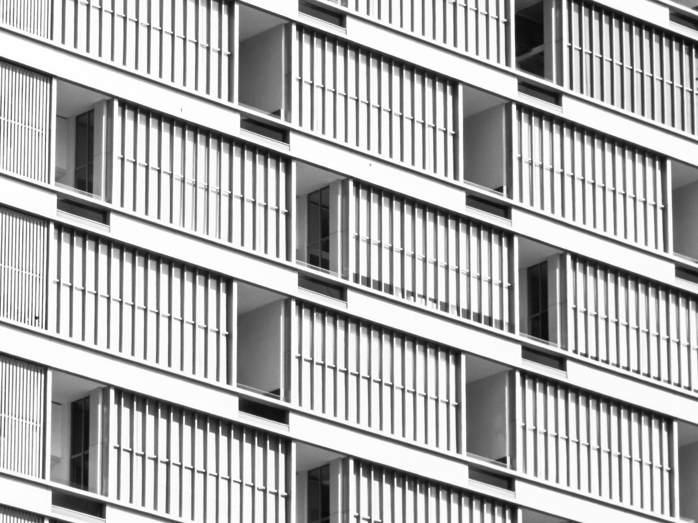
The boy in the tower our summer termly read

Slide 2
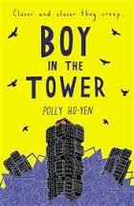
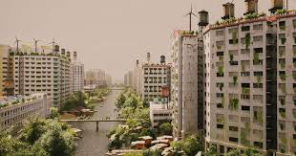
The boy in the tower
Boy in the Tower by Polly Ho-Yen is a gripping dystopian children’s novel about Ade, a boy trapped in his London tower block while mysterious, plant-like "Bluchers" destroy the city. With his mother unable to leave her room due to anxiety, Ade must navigate a crumbling world, friendship, and the fight for survival.
Goodreads +3
ThePhoto by PhotoAuthor is licensed under CCYYSA.

Slide 3
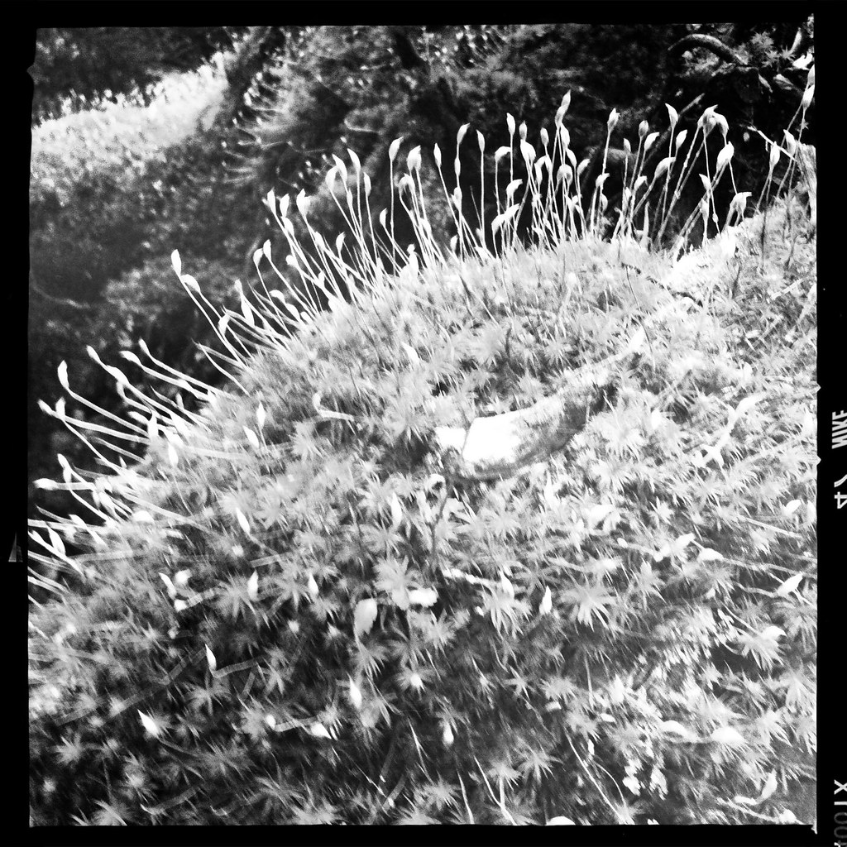
Strange menacing plants begin to appear across london...
When they first arrived, they came quietly and stealthily as if they tip-toed into the world when we were all looking the other way.

Slide 4
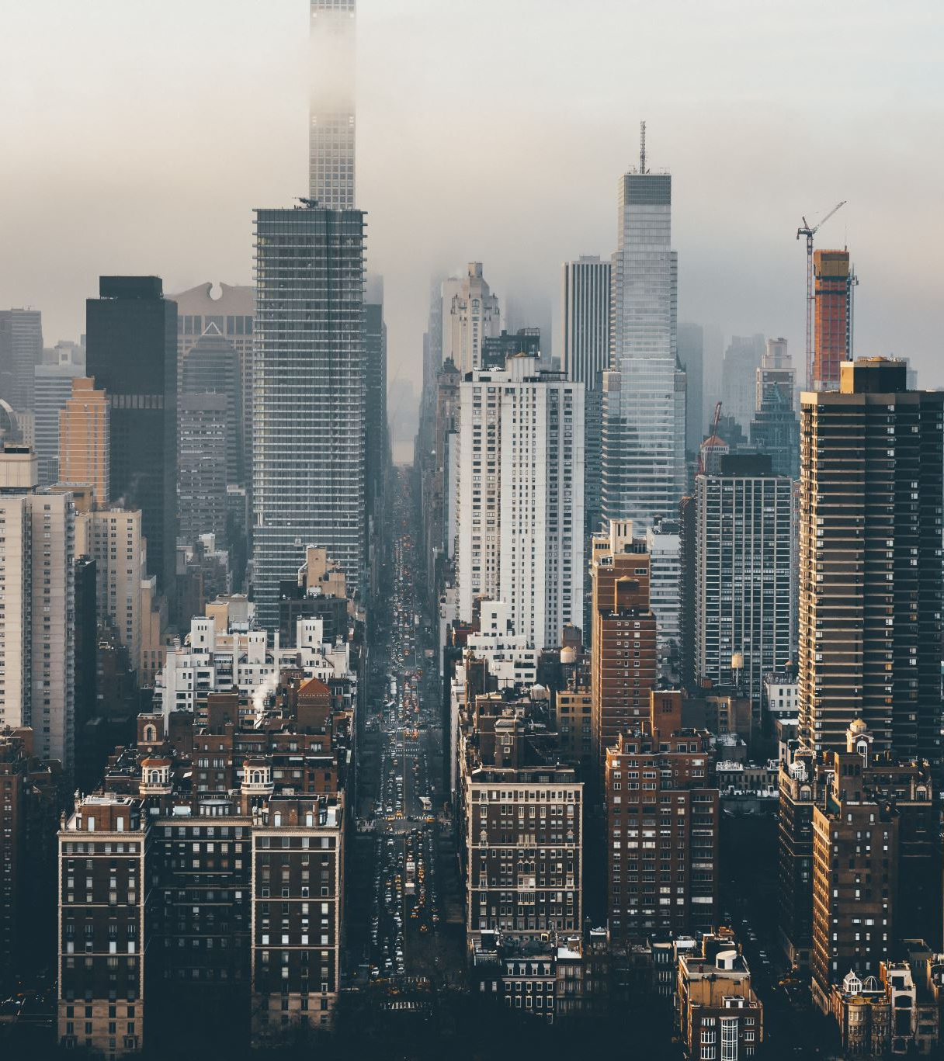
The storline...
The Threat: Strange, fast-growing plants known as "Bluchers" are causing buildings to collapse and forcing residents to evacuate.
The Situation: Ade loves his life at the top of the tower block, but it becomes a prison when the world outside becomes too dangerous to enter.
The Conflict: Ade’s mother refuses to leave their home, forcing them to stay as the city around them empties.
Themes: Friendship, the struggles of young carers, anxiety, bravery, and community.

Slide 5
WE hope you enjoy the termly read however
...if you would like to recommend a novel for next year, please let your English teacher know .

