Slide 1



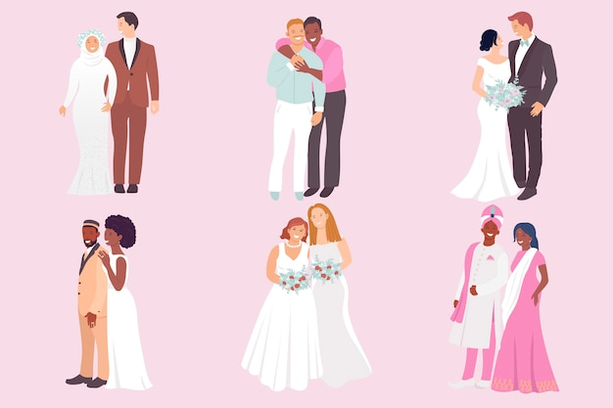




LIFE BEYOND SCHOOL
Rights and Responsibilities
Thursday, 26 February 2026
What is Marriage?
LEARNING OUTCOMES
Knowledge, Skills
& Actions
I can describe what marriage is and what marriage is not
I understand the legal position of gay marriage across different countries in Europe
I can evaluate a range of views on sex before marriage
Why do some couples choose to get married?
What is the most important part of marriage?
NEW VOCABULARY
Marriage, Divorce, Companionship, Commitment, Co-habitation, Civil Partnership, Prenuptial Agreement
3 Minutes
Notes:
TEACHER NOTES & IDEAS
Remind students of the learning journey (What theme you are doing – Possibly recap what they can remember from last lesson)
ATTRIBUTION AND COPYRIGHT
–Icons and logos for Cre8tive Resources are created by Michael Gillman and are subject to copyright ©
- All graphics and images are sourced correctly through the following sites:
Premium licence at https://www.freepik.com/
www.Pixabay.com
https://www.pixelscrapper.com/help
- Factual information is not copyrighted.
- Where information has been taken from reliable 3rd party websites – it is done so for analytical purposes in small pieces of text and for educational purposes.
DISCLAIMER
- Always check the content of any lesson and videos linked before teaching to ensure suitability for your classroom and your school
Responsibility for checking material for suitability for students must be done by the classroom teacher. This includes ensuring everything is appropriate including the external video links that have been provided.
The PowerPoint material is fully editable and we encourage teachers to remove, change or edit anything they wish.
Video links are working at time of creation of this lesson. Please bear in mind YouTube content owners can withdraw their content at any time and responsibility lies with the classroom teacher to ensure the content is updated and new video links are found.
Cre8tive Resources does not charge or provide a subscription update service for this lesson the responsibility for updating lesson content lies with the classroom teacher.
Further Terms and Condition regarding Copyright and our terms of use can be found on our website here https://cre8tiveresources.com/terms-of-use/

Slide 2











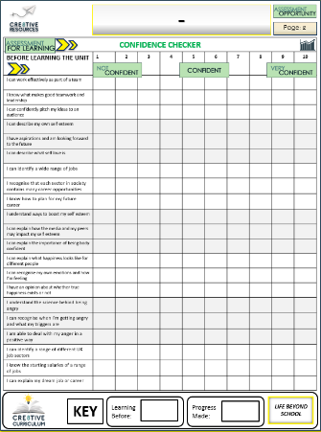

What is Marriage?
BASELINE CONFIDENCE CHECKER
BEFORE THE LESSON
Knowledge, Skills & Actions | 1 | 2 | 3 | 4 | 5 | 6 | 7 | 8 | 9 | 10
I can explain what marriage is and what it is not
I understand gay marriage laws in the UK and Europe
I know a range of different views on the topic of sex before marriage
Complete a baseline assessment of where you think you are at for this lesson
(Discuss or complete sheet)
2 Minutes
I’m not confident at all on this topic
A little confident
Confident
Very
confident
I am super
confident on this topic
Notes:
TEACHER NOTES & IDEAS
This could be done by writing a number down in the books
Show of fingers in the air or red, amber & green cards
Quick partner discussion
Print off the Assessment Opportunity Sheet – Fill in the Baseline Confidence Checker

Slide 3
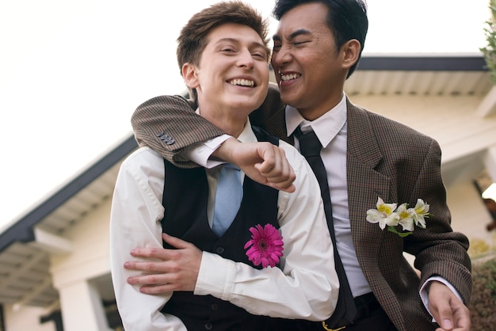


HOW?
WHAT?
WHERE?
WHO?
WHY?
 | DID? | MIGHT? | COULD? | CAN? / WILL? | IS? DOES?
FIRST
SECOND
Using the grid above to help you come up with three questions about the image
2 Minutes
Tasks
Notes:
TEACHER NOTES & IDEAS
Get students to come up with questions using the prompts on the board
Try to get them to think of high level order questions and look past just the image
Extension – Have students try to come up with answers to other students questions
Adapt the image to something you think would be more engaging (We are restricted by Copyright)

Slide 4
Quick Quiz: Multiple Choice
A
Which of the following is NOT a reason people get married?
Love
Financial Stability
Social Status
Boredom
B
Which UK country was last to legalise same-sex marriage?
England
Scotland
Wales
Northern Ireland
C
What is a wedding vow?
A promise made by the couple during the wedding ceremony to love and honour each other
A legal document signed by the couple before the wedding
A gift given to the bride or groom on the wedding day
A religious ritual performed during the wedding ceremony
D
What is a prenuptial agreement?
A contract signed before getting married to protect individual assets in case of divorce
A religious ceremony performed before a wedding
A gift given to the bride or groom before the wedding
A promise to be faithful and loyal to each other for life
Notes:
TEACHER NOTES & IDEAS

Slide 5
Quick Quiz: Multiple Choice
A
Which of the following is NOT a reason people get married?
Love
Boredom
Financial Stability
Social Status
Boredom
B
Which UK country was last to legalise same-sex marriage?
England
Northern Ireland
Scotland
Wales
Northern Ireland
C
What is a wedding vow?
A promise made by the couple during the wedding ceremony to love and honour each other
A promise made by the couple during the wedding ceremony to love and honour each other
A legal document signed by the couple before the wedding
A gift given to the bride or groom on the wedding day
A religious ritual performed during the wedding ceremony
D
What is a prenuptial agreement?
A contract signed before getting married to protect individual assets in case of divorce
A contract signed before getting married to protect individual assets in case of divorce
A religious ceremony performed before a wedding
A gift given to the bride or groom before the wedding
A promise to be faithful and loyal to each other for life
Notes:
TEACHER NOTES & IDEAS

Slide 6
Can you fill in the blanks?
To have and ___ _____ from this day ________,
for better, __ ___ ___, for richer, ___ ___ ____,
in sickness and ___ ________,
to love and __ ________
till ____ ___ ___ ______.
DO ALL MARRIED COUPLES STICK BY THIS?
WHAT CAN CAUSE CONFLICT IN A RELATIONSHIP?
SHOULD ALL COUPLES FOLLOW THIS?
WHAT WAS THE LAST CONFLICT YOU WERE INVOLVED WITH?
Notes:
TEACHER NOTES & IDEAS

Slide 7



-
-
Marriage is…..
Marriage is not…..
-
Tasks
Create a wall of definition with what marriage is and what marriage is not
(Bring your ideas to the board on post-it-notes)
Notes:
TEACHER NOTES & IDEAS

Slide 8
Commitments
Task
Imagine that you were ​making a ​commitment of love to ​someone.​
Write down ​two​ promises that you would want them to make to you and explain why…
I want you to always ………..
I want you to never …………
Notes:
TEACHER NOTES & IDEAS

Slide 9
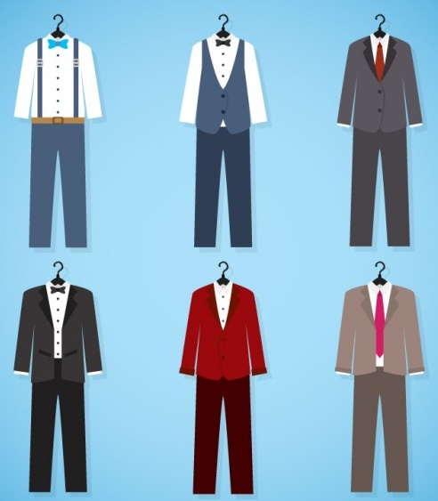
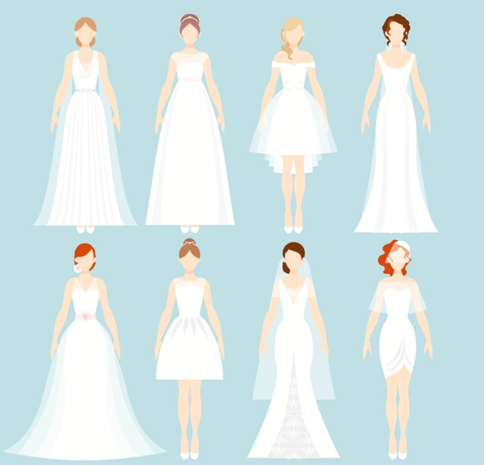
What Would You Wear?
Would you choose something traditional or something else?
Notes:
TEACHER NOTES & IDEAS

Slide 10
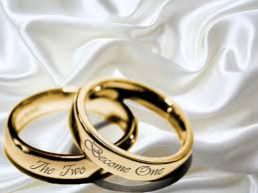
Why Do People Get Married?
One of the most common reasons why people get married is for the love and companionship that comes with being with someone special.
In many cultures, marriage is seen as a natural progression in life, and people feel societal or familial pressure to get married, especially as they approach a certain age.
Some people get married because of their religious or spiritual beliefs. Marriage is often seen as a sacred institution in many religions, and couples may choose to get married as a way of solidifying their commitment to each other before their god.
Marriage can provide emotional security, especially for those who have experienced traumatic or difficult childhoods. Being with a partner who is committed to you can help create a sense of safety and stability.
Many people get married with the intention of starting a family. They want to create a stable and secure environment for their children to grow up in, and believe that marriage is an important foundation for building a family.
For some people, getting married is a way to achieve financial stability. Two incomes can be better than one, and pooling resources can make it easier to buy a home, start a business, or achieve other financial goals.
Notes:
TEACHER NOTES & IDEAS

Slide 11


Marriage
Marriage between persons of the same-sex.
A
Civil Partnership
A legal relationship which can be registered by two people who aren't related to each other.
B
Same-Sex Marriage
Living together without being married.
C
Cohabitation
A legally recognised union between two consenting individuals that involves commitment, companionship, and mutual support.
D
Match the key word with its correct meaning
Notes:
TEACHER NOTES & IDEAS

Slide 12

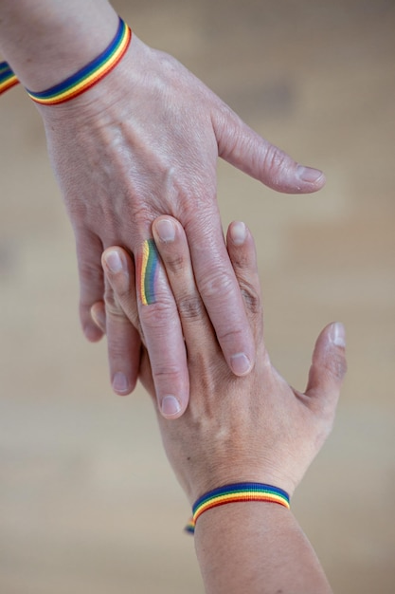
Marriage in the UK
Before 2004 marriage in the UK was defined as ‘the legal union of a man and a woman’.
However, in 2004 same sex couples were allowed to register their union in civil partnership ceremonies that gave them the same rights as heterosexual couples.
On July 17, 2013, Queen Elizabeth II gave her “royal assent” to a bill legalizing same-sex marriage in England and Wales. (Scotland Followed in Early 2014)
Same-sex marriage in Northern Ireland has been legal since 13 January 2020, following the enactment of the
Northern Ireland (Executive Formation etc) Act 2019.
The first marriage ceremony took place on
11 February 2020
Notes:
TEACHER NOTES & IDEAS

Slide 13


Which Countries Allow Same-Sex Marriage?
UK
RUSSIA
FRANCE
UKRAINE
TURKEY
SPAIN
POLAND
Notes:
TEACHER NOTES & IDEAS

Slide 14
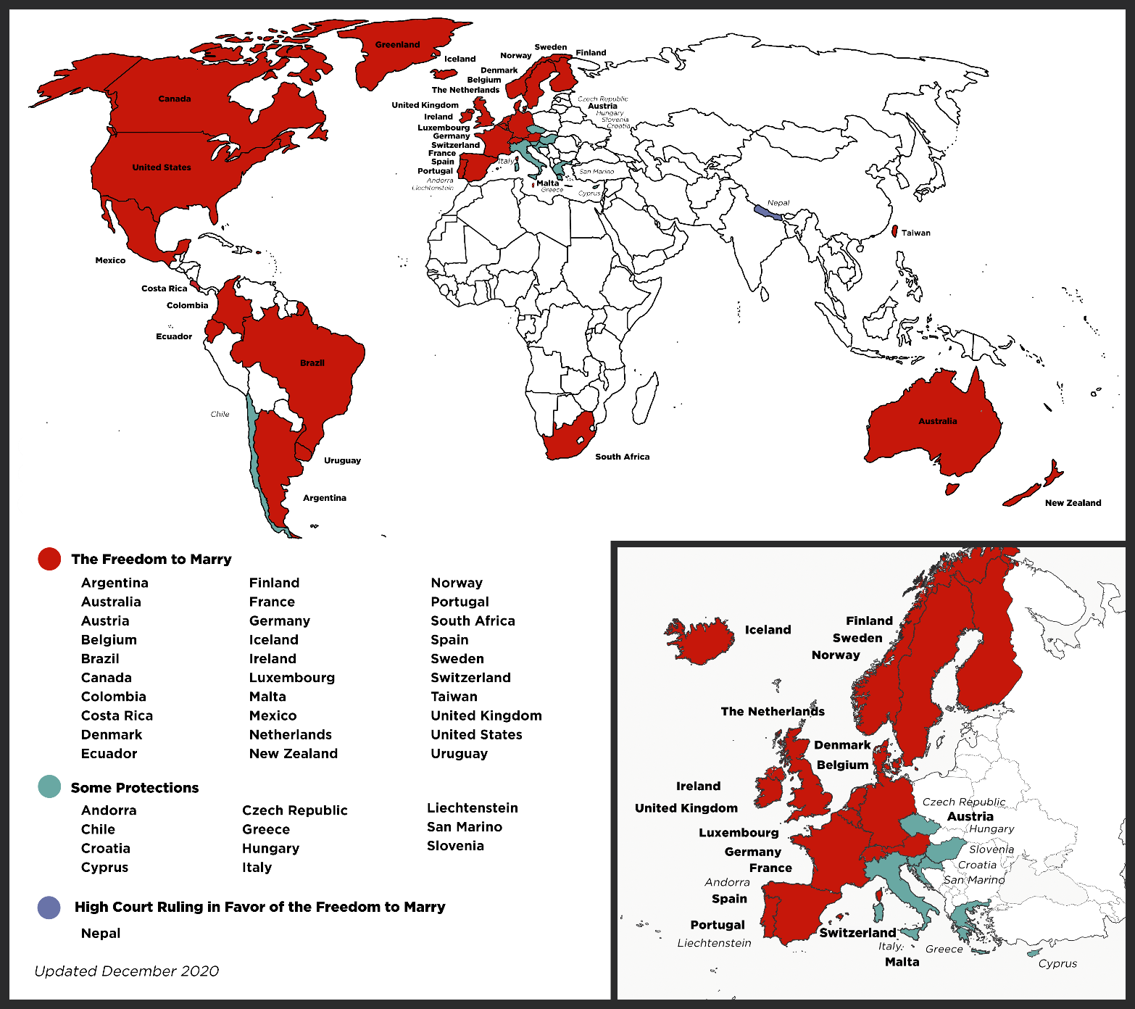

Same Sex Marriage Around the World
GAY MARRIAGE MATTERS
3 Minutes
Image Source
http://www.freedomtomarry.org/pages/the-freedom-to-marry-internationally
Notes:
TEACHER NOTES & IDEAS

Slide 15


Sex Before Marriage Debate
Against sex outside of marriage
For sex outside of marriage
Both / Not sure
Sex is something special and should be saved for the ‘one’
Would put an end to promiscuity
It is against your religion
How do you know you want to marry them if you haven’t seen if your compatible in bed
Sex before marriage cheapens the act
Sex after marriage would slow the spread of STI’s and HIV
Sex is fine in a loving long term relationship
Sex is enjoyable
Contraception means sex before marriage can be safe
A child should be raised in a secure family unit (parents married)
Notes:
TEACHER NOTES & IDEAS

Slide 16





What Do You Think?
“People should not have sex before marriage and marriage should only be for a man and a woman”
Talking Points
I think that …
I don’t think… is right because…
My opinion is…
I would argue the same because…
I disagree with… because…
Building on what… said. I think…
An alternate way of looking at this is…
I sort of agree, however….
I would challenge what.. said because ...
?
Do you agree or disagree? Why?
Can you add to the statement?
Do you have a question about the statement?
Would you like to challenge what is being said?
Do you have an alternative idea?
Notes:
TEACHER NOTES & IDEAS
Ask students what they think of this statement
Reveal the talking points after some discussion time
To provoke discussion with a quiet class – play devil's advocate
Challenge a student to a debate

Slide 17
REVIEW YOUR LEARNING OUTCOMES
CONFIDENCE CHECKER
AFTER THE LESSON
Knowledge, Skills & Actions | 1 | 2 | 3 | 4 | 5 | 6 | 7 | 8 | 9 | 10
I can explain what marriage is and what it is not
I understand gay marriage laws in the UK and Europe
I know a range of different views on the topic of sex before marriage
Complete the confidence checker of where you think you are at for this lesson
(Discussion or complete sheet)
3 Minutes
I’m not confident at all on this topic
A little confident
Confident
Very
confident
I am super
confident on this topic
Notes:
TEACHER NOTES & IDEAS
This could be done by writing a number down in the books
Show of fingers in the air or red, amber & green cards
Quick partner discussion
Print off the Assessment Opportunity Sheet – Fill in the Baseline Confidence Checker

Slide 18




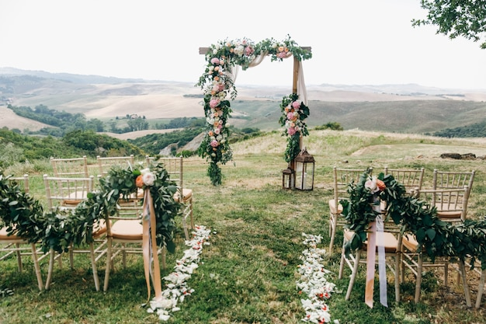



Homework Explained
Write two paragraphs on what you think the perfect wedding day would look like.
DUE DATE
It must be submitted by..
Hand / Google Classroom
Notes:
TEACHER NOTES & IDEAS

Slide 19




Next lesson I would like to...
A question I would like to ask is…
I would like to learn more about…
I know if I need further support or help I could speak to…. or contact…
I now know I can supported others by…
One thing I didn’t realise was… this will help me to…
A problem I overcame today was…
Before I only knew...
now I also know...
The key words for this lesson were…
I’m really proud of the way I have…
Today I have tried to…
The most important thing I have learnt today is…
I used to feel ... but I now feel …
Before I would have done…
Now I will …
2 Minutes
Notes:
TEACHER NOTES & IDEAS
Have students pick either 1-3 tickets depending on their ability and tell a partner
Pick a few students at random to feedback to the class
As students leave the room, have them tell you their reflection on the way out
ATTRIBUTION AND COPYRIGHT
–Icons and logos for Cre8tive Resources are created by Michael Gillman and are subject to copyright ©
- All graphics and images are sourced correctly through the following sites:
Premium licence at https://www.freepik.com/
www.Pixabay.com
https://www.pixelscrapper.com/help
- Factual information is not copyrighted.
- Where information has been taken from reliable 3rd party websites – it is done so for analytical purposes in small pieces of text and for educational purposes.
DISCLAIMER
- Always check the content of any lesson and videos linked before teaching to ensure suitability for your classroom and your school
Responsibility for checking material for suitability for students must be done by the classroom teacher. This includes ensuring everything is appropriate including the external video links that have been provided.
The PowerPoint material is fully editable and we encourage teachers to remove, change or edit anything they wish.
Video links are working at time of creation of this lesson. Please bear in mind YouTube content owners can withdraw their content at any time and responsibility lies with the classroom teacher to ensure the content is updated and new video links are found.
Cre8tive Resources does not charge or provide a subscription update service for this lesson the responsibility for updating lesson content lies with the classroom teacher.
Further Terms and Condition regarding Copyright and our terms of use can be found on our website here https://cre8tiveresources.com/terms-of-use/

Slide 20





REFER TO MINDFULNESS POWERPOINT
Time for a little something extra?
?? Minutes
Notes:
TEACHER NOTES
Time for something extra?
Pick an activity or reflection question from the mindfulness and wellbeing PPT or add the activity you want on to the end of this PowerPoint before you start the lesson (or use as a starter)

