Slide 1
Zones of Regulation
Scott Archibald – The Pilgrim School

Slide 2
Zones of regulation
Zones of regulation is a tool that we have to use to help pupils to understand their emotions.
The aim of zones of regulation is to help support us as staff to help support a pupil towards self regulation.

Slide 3
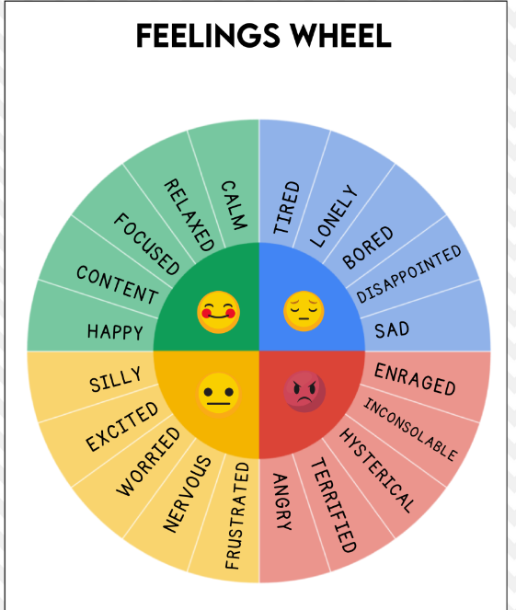
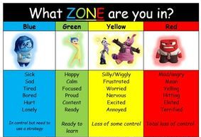
Using colour's to describe our emotions we can take away some of the difficulties in describing and processing how we feel.
It is important to let pupils know all zones are ok and natural
Inside out is an excellent film to refer too if pupils have seen it to help them understand. (lots of resources online that can be used a long side the film to help)

Slide 4
What are the zones?
Red – Is used to describe a state of extremely heightened energy and intense overwhelming feelings which are harder to control. This can range from elate to terrified.
Blue – Is used to describe a low state of alertness and down feelings such as sadness or boredom.
Yellow – Is used to describe a heightened sense of alertness however unlike red there is an element of control here but starting to feel less in control. Silliness, confusion, nervousness.
Green – is used to describe calm alert state. Calm happy focused when in green. The nervous system feels safe mean it’s a prime condition to learn

Slide 5
How can this help?
Through understanding of each colour in the zones of regulation we can find ways to best support learners and help learners find ways that best supports themselves.
Every person zones of regulation will look different something that might make one person feel red could make someone else yellow or blue.
On the next slide we have examples of two complete zones of regulation documents, one for a pupil and one of our school dog which is a good example we can use as a WAGOLL to help pupils understand.

Slide 6
Try it for yourself
The best way to get your head around the zones of regulation idea is to try it for yourself.
Using the prompt cards given discuss in groups how each one makes you feel. What strategies would you use to help you regulate in this scenarios?

Slide 7





How can Otto support themselves?
Tired
Anxious
Overwhelmed
Calm
Content
Waggy
Barky
Bouncy
Uncertain
Beyond excited
Angry/Frustrated
Wired (over tired)
The BLUE Zone
The GREEN Zone
The YELLOW Zone
The RED Zone
How might Otto feel?
How might Otto feel?
How might Otto feel?
How might Otto feel?
What might help Otto?
What keeps Otto green?
What might help Otto?
What might help Otto?
Quiet down time
Kong
Sleep
Being with Bev
Calm environment
Rest breaks/wanders
Treats/water
Cuddles/calm play
Quiet down time
Snuffle mat/Long chew
Tug toy
Being with Bev
Quiet down time/calm walk
Sleep
Re-direction to a favourite toy
Firm commands

Slide 8
How can support themselves?
The BLUE Zone
The GREEN Zone
The YELLOW Zone
The RED Zone
How might feel?
How might feel?
How might feel?
How might feel?
Bored
Tired
Quiet
Grumpy
Calm
Focused
Ready to learn
Fast speaking
Distracted
Fidgety
Medium sensory overload
Excitable
Grumpy
Hangry
Big sensory overload
Overly excitable
What might help ?
What keeps green?
What might help ?
What might help ?
Sensory circuit
Sand – sensory play
Walk outside
Park
Otto
Quick and short activities
Lots of breaks
Work on the floor
Fidget tray
Otto
Pushing something heavy
Sand – controlled activity (e.g., spelling)
Sit on the floor
Exercise equipment
Lay on the floor
Offer snack
Exercise equipment
Controlled activity (e.g., catch)

Slide 9
How it looks in practice for us?
When a pupil gets identified as needing support with regulation a member of staff and the pupil sit down and discuss how they feel for each zone.
This is then put into the document seen previously and shared with staff and attached to pupil passports.
These documents are live documents.
Pupils are encouraged to let staff know when they have any thing they want to add.
Staff to use the vocabulary so that pupils are exposed to language often.

Slide 10
Questions
Resources can be found online at https://zonesofregulation.com/resources/
Zones of regulation curriculum can also be purchased here the book has lesson plans and resources to help teach about self regulation and emotional control in more detail.

