Slide 1
WARM Welcome
Parent Connect
22nd January 2026

Slide 2
Introductions – the team
Careers and Community Liaison Manager
Sharon Smith – Asst Headteacher
Chloe Massingham PSWS
Lynne Armstrong PSWS
Gen Rosenberg Admin
Eva Stanton Admin

Slide 3
Why?
Due to the nature of our school all our parents are county wide and remote from one another
An opportunity to meet other parents together with support from us

Slide 4
What will we try to do
To give parents openings to a range of workshops/forums we think you may find useful
We welcome feedback, so if there's something you are interested in please let us know – from last years feedback we have added sessions/varied times

Slide 5
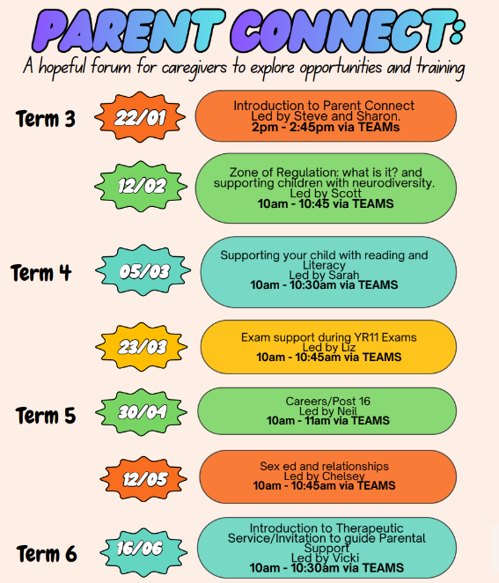
Plan for this academic year
Reminder letters will be sent out on Reach more parents app
Information is also on the website and social media
Parent connect email:
parent.connect@pilgrim.lincs.sch.uk

Slide 6
Today
Steve Barnes – Headteacher
Hope

Slide 7
Reminder
Tomorrow we have a session with Jamie Bagley from Aspire academy
Amber Hill and teams 10 to 11.30
Courses to help with accessing work in schools – eg class room support

Slide 8
Thankyou!
Any feedback is gratefully received

Slide 9

Why We Can Be Sure of Hope
Steve Barnes

Slide 10
Introduction:
Why is hope important to us?
How do we do it in school?
How can we make hope brighter?

Slide 11
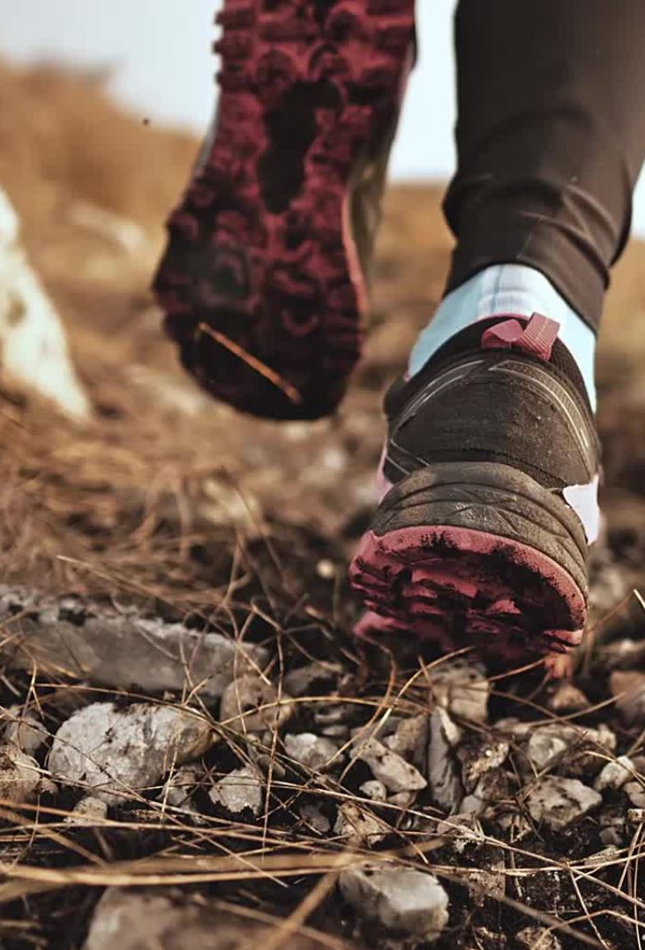
Wearing the Mantle of the Guide and not that of the Expert.
We are not, and never have claimed to be, experts.
We have not walked in the shoes of you and your family, but we will walk alongside you for the time that your child is with us.
We do not judge
We are not perfect, and we will make mistakes
We do not believe that your child needs fixing
We believe that the role of a school is to teach and strengthen children and young people.
We believe that people who have discovered purpose and meaning in their life will be happier, do better and enjoy life more than those who have not.
We believe that being hopeful will strengthen your child and help them face the world, but it will not change the world.

Slide 12

Our Hope Journey
We have been journeying with hope for a long time – since 2018(ish)
We wanted to find an underpinning that would pull the school together and give equal weight to academic learning and the personal development curriculum - coherence was the key

Slide 13
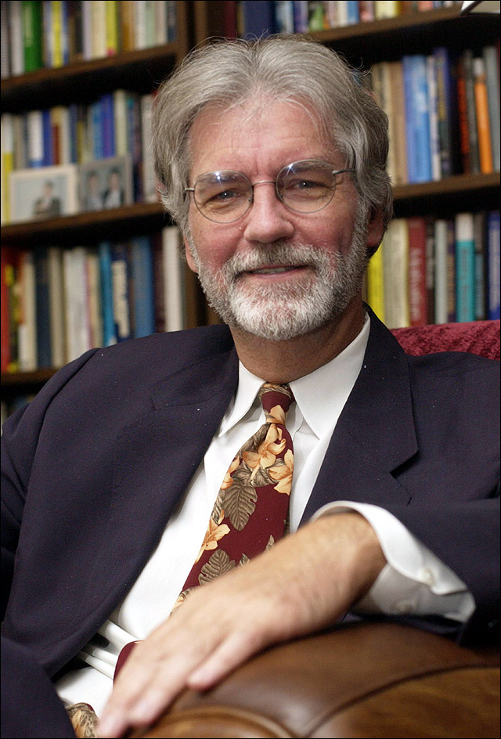
But what is hope?
The most popular form of Hope theory was articulated by an American Psychologist named Rick Snyder.
His seminal article was Snyder, C.R, Hope Theory- Rainbows in the Mind, Psychological Inquiry, Vol. 13, No 4. (2002), pp 249 – 275
Snyder described hope as being a cognitive (thinking) process – not an affective (feeling – emotional process)
Hope involves setting goals
Hope involves finding pathways
Hope involves having the agency (the belief that you can do it)
https://www.youtube.com/watch?v=Op4bp9hKV7Y

Slide 14

How Can we begin to think hopefully?
You can begin to think hopefully by:
Setting yourself a goal to achieve – it should be something, big or small, that you are uncertain that you can do but it would not be impossible
Plan a little plan – but don't just think of one way to achieve your goal. Have you got different plans? This is important because if we plan fails or faces a big challenge then we need to have alternative plans in place.
Have a little bit of grit – there will always be times when things are hard or seem impossible. Sometimes we need to dig a little bit deeper and hold the moment. These moments are usually fleeting and temporary and will usually pass.
Reaching out – people in the school usually will help each other – pupils and staff alike. This is not the same as doing things for you. But a helping hand is usually given.

Slide 15

Why is this important?
People with higher levels of hope will be able to describe a better future for themselves.
People with higher levels of hope can better describe a life that has meaning and purpose.
People with higher levels of hope will do better in school.
People with higher levels of hope will tend to have better or improving mental health
People with higher levels of hope will tend to have better or improving physical health

Slide 16
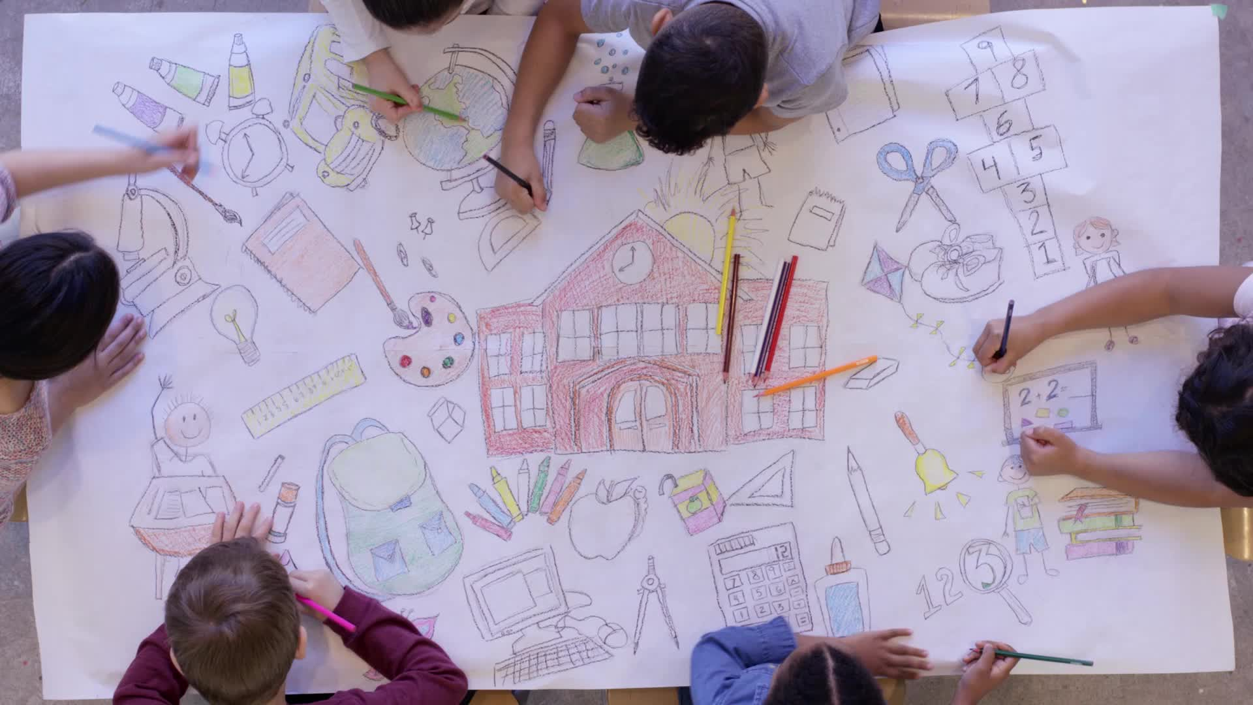
How do we do this?
We have drawn upon the work of a psychologist named Albert Bandurra.
He says that we learn from 4 broad areas:
We do this by building mastery experiences, both inside and outside the classroom.
We do this by telling hopeful stories to the pupils.
We do this by teaching hopeful words to the pupils
We do this by building hopeful relationships with the pupils

Slide 17
Learning Hopeful Words
Kintsuigi: the Japanese art of putting broken pottery pieces back together with gold – embracing the idea that in embracing flaws and imperfections you can create even stronger, more beautiful piece of art. Every break is unique and instead of repairing an item like new, the 400-year old technique highlights the "scars" as part of the design. Using this as a metaphor for healing ourselves teaches us an important lesson; sometimes in the process of repairing things that have broken, we actually create something more unique, beautiful and resilient.
Ubuntu: An African word. This word means “humanity to others.” I am because we all are. The belief in the universal bond of sharing that connects all humanity.
Wabi Sabi: The aesthetic is sometimes described as one of appreciating beauty that is "imperfect, impermanent and incomplete" in nature. Finding beauty in imperfections; the acceptance transience.
Eunoia: Greek: Beautiful thinking from a beautiful mind. Goodwill to others. A pure and well-balanced mind, a good spirit. “Beautiful thinking”.
Sisu: To the Finnish people, Sisu has a mystical, almost magical meaning. Sisu is a unique Finnish concept. It is a Finnish term that can be roughly translated into English as strength of will, determination, perseverance and acting rationally in the face of adversity. An extraordinary strength and persistent resolve to continue and overcome in the face of adversity.
Ikigai: a Japanese concept referring to something that gives a person a sense of purpose, a reason for living. Something that makes you get out of bed in the morning.
Storge: A Greek word for love, but the love that is instinctive and deeply caring and nurturing.
Familial love; natural, unforced, stable and committed.
Meraki: This is a word that modern Greeks often use to describe doing something with soul, creativity or love – when you put "something of yourself into" what you're doing, whatever that may be: to put something of yourself into your work.

Slide 18

Ikigai
A Japanese term meaning 'A reason to live'
'Iki' means 'to live' and 'Gai' means 'reason'

Slide 19
Ikigai – The Happiness of Always Being Busy
The island of OKINAWA, off the coast of Japan, has one of the highest life expectancies in the world. It is part of the world known as the “blue region” where people have very high life expectancies.
On Okinawa they have 24.55 people over the age of 100 for every 100 000 inhabitants.
They have a very healthy diet, they do not smoke or drink excessively. They drink green tea, they have a simple life outdoors. They have nurturing friendships, eat light, have enough rest and take moderate exercise. They also have IKIGAI.

Slide 20

Ikigai – The Happiness of Always Being Busy
Japanese letters have meaning. Ikigai is written as
The first two characters mean – life, to live, birth, person or raw
The third and fourth characters mean – worth, value, benefit or effect.
It is loosely translated as a “life worth living” but it could also mean:
A life that has benefit (to others) or a life that effects (others). It can also mean a person who has worth, value, benefit to and effect others.
A key discussion point here with children is that value and benefit to others is a relational idea.

Slide 21
Viktor Frankl – Logotherapy
A psychiatrist who was a survivor of Auschwitz. After the war he used the idea of logotherapy to help people discover their purpose in life, their why.
“Everything can be taken from a man but one thing: the last of human freedoms – to choose one’s attitude in any given circumstances, to choose one’s own way”
Nietzche’s famous aphorism – “He who has a why to live for can bear almost any how”
This can create for people an existential crisis – people do what they are told to do, or what others do, rather than what they want to do.

Slide 22
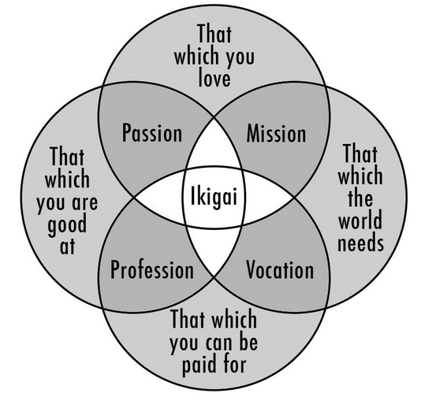
Discovering your why
Ikigai is the belief in the value of life and the potential for happiness when you're aligned with your purpose. Finding your Ikigai helps you to lead a meaningful life with intention.
If you have something you are good at and you can be paid for it then you have your profession.
If you know what you are good at, and it is something you love you have found your passion.
If you know what it is you love and it is what the world needs you have your mission
If you know what the world needs and you can be paid for it you have your vocation.
All four and you have your Ikigai.

Slide 23

Cultivate your profession
Do you know what you are good at, do you know what you excel at? Do you know what you can be paid for? If you have identified that you have identified your profession.
You might be a skilled musician, you might understand how things work and are put together, you might be a talented writer?
What job could you get with the skills that you have?

Slide 24

Unveil your passion
Passion is made up of what you are good at and that which you love doing.
It might be a subject at school, it might be a hobby or interest, it might be helping others. It is something unique to you.
Sometimes when you are working on something you are passionate about time “flies by”
Sometimes psychologists call this flow.

Slide 25

Recognise your Mission
What do you love to do? What do you do and time feels like it not important?
What does your world need – what can you contribute that others cannot?
It might be big, or it might be small, but it is important and matters.

Slide 26

Benefits of finding your Ikigai
Aligning with the core principles of Ikigai is a continous process of self–discovery and growth and can provide many benefits to you and the community around you.
Increased happiness
Reduced stress
A sense of fulfillment
Enhanced motivation
Improved health
Personal growth

Slide 27
The best way to find your Ikigai is to draw an Ikigai venn diagram.
ThePhoto by PhotoAuthor is licensed under CCYYSA.

Slide 28
Impact
How would you be feeling now if I asked you to complete your Ikigai Venn diagram now?
Instead look at this story from a Pilgrim past pupil – can we pick out the elements of ikigai in this young person’ story?
Their passion (what you love)
Their vocation (what you're good at)
Their mission (what the world needs)
Their profession (what you can be paid for)

Slide 29
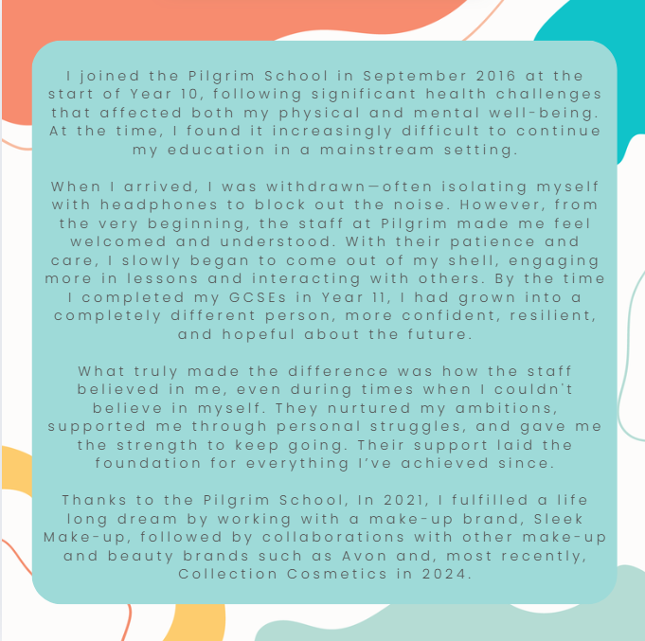
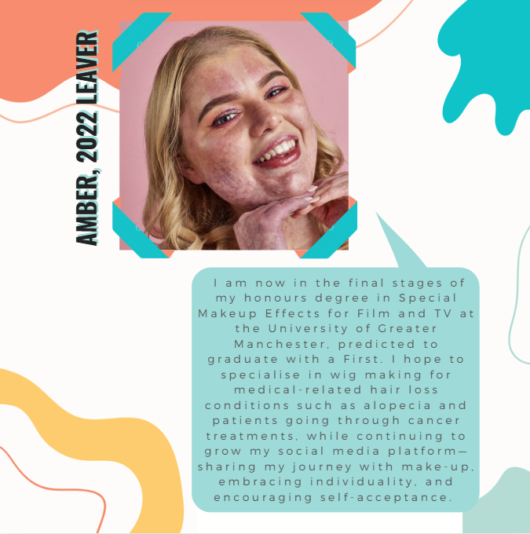

Slide 30
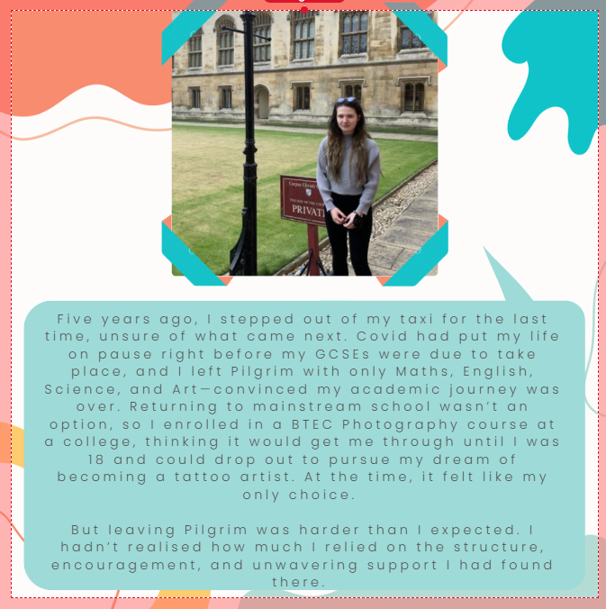
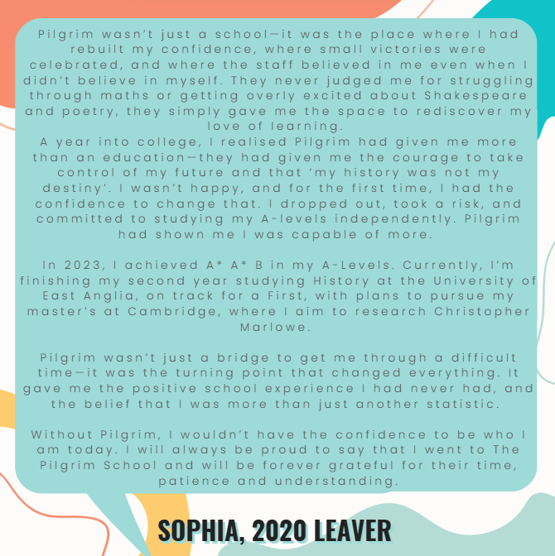

Slide 31

How Can We Make Hope Brighter?
What can we do to help?

Slide 32
Thank you
someone@example.com

